Slide 1
Predicting Used Car Prices
Machine Learning Model for Price Prediction

Slide 2
Introduction
Project Overview:
The goal of this project is to develop a machine learning model to predict the prices of used cars accurately. This helps in providing pricing recommendations, optimizing inventory management, and aiding buyers and sellers in making informed decisions.
Objectives:
To analyze used car data and identify key factors affecting car prices.
To build a classification model to predict price ranges.
To evaluate the model's performance for real-world applicability.

Slide 3
Dataset Description
Dataset Name: ‘usedCar.csv’
Key Features:
ID: Unique identifier for each listing
Company: Car manufacturer
Model: Car model name
Variant: Variant of the model
Fuel Type: Type of fuel used (Petrol, Diesel, CNG, etc.)
Color: Car color
Kilometer: Distance driven
Body Style: Type of car body

Slide 4
Dataset Description
Key Features:
Transmission Type: Manual or automatic
Manufacture Date: Production date
Model Year: Year of the car model
CngKit: Presence of a CNG kit.
Price: Car price (Target variable)
Owner Type: Number of previous owners
DealerState, Dealer Name, City: Dealer and location information
Warranty: Warranty details
Quality Score: Assessment of car condition

Slide 5
Data Preprocessing
Steps Taken:
Numeric Transformer: scaled with StandardScaler.
Categorical Transformer: one-hot encoded.
ColumnTransformer: Combines the numeric and categorical pipelines to apply the respective transformations to the proper columns.
Outlier Removal: Used IQR method to remove extreme values from numeric features.
Missing Value Treatment :
FuelType: Filled missing values with the mode.
TransmissionType: Filled missing values based on the car model’s most common transmission type.
CngKit: Filled missing values with its mode.
Data Cleaning:
Removed extra strings from Price and Owner columns.
Stripped whitespace from categorical variables like BodyStyle.

Slide 6
Feature Engineering
Derived Features:
CarAge:
If the "ModelYear" column is present, a new feature called CarAge is created by subtracting the model year from the current year. This gives an estimate of how old the car is.
Feature Selection:
features = Company, FuelType, Kilometer, BodyStyle, Colour, CngKit, DealerName, City, DealerState, TransmissionType, Owner, Warranty, QualityScore, CarAge.
target = Price

Slide 7
Model Training
Code :
X = df.drop(columns=[target])
y = df[target]
X_train, X_test, y_train, y_test = train_test_split(X, y, test_size=0.2, random_state=42)
Train Test Split : We divided the data into training(80%) and testing (20%) sets.

Slide 8
Model Selection
Models Trained:
Decision Tree Regressor
Random Forest Regressor
Gradient Boosting Regressor
XGB Regressor
Model Choice Justification: The XGBoost model is considered the best because it has the highest R² Score (0.7721), which indicates it explains approximately 77.21% of the variance in the target variable (Price).

Slide 9
Performance Evaluation
Metrics Used:
Mean Squared Error (MSE)
Mean Absolute Error (MAE)
R² Score (Explained Variance)
Visuals:
Scatter plot: Actual vs. Predicted Prices.
Residual plots to inspect errors.

Slide 10
Feature Importance & Insights
Feature Importance Scores (from XGBoost):
Kilometer : Most significant factor (high negative correlation with price)
CarAge : Older cars tend to have lower prices
TransmissionType : Automatic cars are generally priced higher
Company : Brand reputation significantly affects pricing
FuelType : Diesel cars often have a price advantage
QualityScore : Higher quality scores indicate better-maintained cars
Owner : First-owner cars have higher resale value

Slide 11
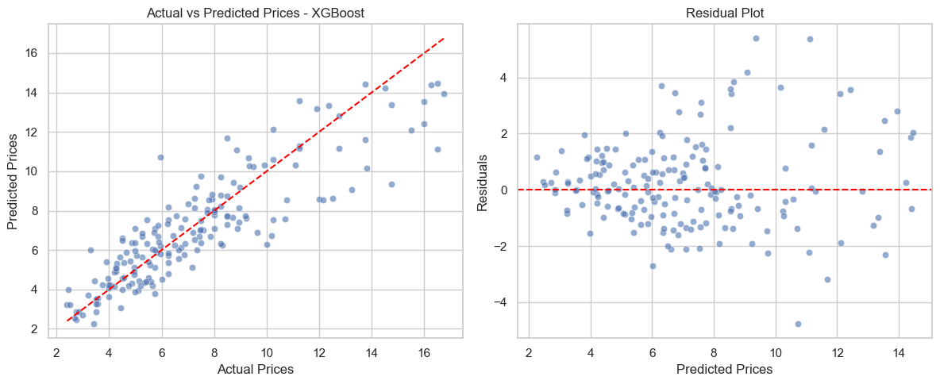
Results and Analysis
Model Performance: XGB Regressor
XGBoost Regression Metrics:
MSE: 2.4548 , MAE: 1.1573, R2 Score: 0.7721
XGBoost Accuracy (R2 Score): 0.7721

Slide 12
Model Comparison & Results Summary
Accuracy Comparison (R² Scores):
Decision Tree: ~0.5979
Random Forest: ~0.7356
Gradient Boosting: ~0.7657
XGBoost: ~0.7721 (Best)
Interpretation:
XGBoost shows the best performance with the highest R² and lowest error metrics

Slide 13
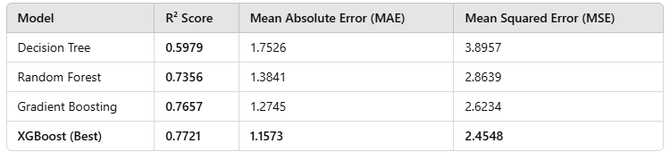
Model Comparison & Results Summary
📌 Why XGBoost? ✅ Best R² Score (77.21% of price variance explained) ✅ Lowest Error Rates (MSE & MAE) ✅ Faster performance and strong feature importance insights

Slide 14
Conclusion
"This project demonstrates how machine learning can be used to accurately predict used car prices.
While our XGBoost model performed the best, there are exciting opportunities for future improvements.
With more data, advanced models, and real-time deployment, this system can become an effective tool for pricing cars in the used car market!"

Slide 15
Future Work
Include additional external data (e.g., market trends, inflation rate, demand, seasonal changes)
Ensemble Learning: Blend XGBoost with LightGBM to improve predictions.
Deep Learning: Try Neural Networks (TensorFlow, PyTorch) for complex feature interactions.
Deploy as an API for real-world usage.

Slide 16
Thank You

